Slide 1
ADAPTIVE SOFTWARE ENGINEERING (24CI3201) | REVIEW-2
AI-Based Emergency Patient Prioritization and Resource Optimization
BATCH – 4
TEAM MEMBERS
2420030331 – Varsha
2420090003 – Sri Kruthi
2420090007 – Sri Satya
GUIDE
Mr. Rajkumar Patil
Koneru Lakshmaiah Education Foundation (KLEF), Hyderabad

Slide 2
PROBLEM STATEMENT
Unpredictable Patient Inflow
Slow, Inconsistent Manual Triage
Strain on Staff & Patients
Emergency departments receive a continuous, unpredictable stream of patients with very different severity levels.
Manual triage takes time and varies between staff and shifts, delaying identification of critical cases.
Delays raise waiting times and put avoidable pressure on emergency staff.
NEED A real-time AI triage platform that surfaces the most critical patients first and gives staff a consistent, data-driven decision aid.

Slide 3
OBJECTIVES
Build an AI-powered patient care platform for emergency departments
Streamline the journey from registration to disposition
1
2
Develop a triage scoring model refined with machine learning
Provide role-based dashboards for doctors, nurses and admins
3
4
Keep a live queue that re-orders as patients arrive or change
Log staff overrides and use them to retrain the model
5
6

Slide 4
EXISTING SYSTEM
Current method
Limitations
Nurse assesses vitals and symptoms manually
Patients assigned a triage level (e.g. ESI) by judgement
Paper or basic registration records
Queue order managed by staff memory or whiteboards
Slow during high patient volume
Inconsistent across staff and shifts
Queue does not re-order when a patient deteriorates
No learning from past decisions
High cognitive load on staff

Slide 5
PROPOSED SYSTEM
An AI triage platform between patient intake and clinical care: vitals and symptoms are scored by an ML model, patients are ranked in a live queue, and staff can override with every override fed back to improve the model.
Faster critical detection
Consistent scoring
Adaptive queue
Severity scored in seconds
Same criteria for every patient
Re-orders live on new data
Human-in-the-loop
Continuous learning
Lower staff load
Staff can always override
Overrides retrain the model
Decision aid, not guesswork

Slide 6
TECHNOLOGY USED
Frontend
Backend
Machine Learning
React.js (Vite), Axios, WebSocket client
Python, FastAPI, Uvicorn, SQLAlchemy
scikit-learn, XGBoost, pandas, NumPy, joblib
Database
Real-time
Tools
PostgreSQL
WebSockets for live queue updates
VS Code, Git & GitHub

Slide 7
WORKFLOW
Registration & Intake
Vitals & Symptom Capture
AI Triage Scoring
Live Priority Queue
Role-based Dashboard
Case Tracking
Doctor overrides tier → logged → model retrained on feedback
Each patient flows left to right; the dashed loop is the adaptive feedback cycle.

Slide 8
MODULES
1 Registration & Intake
2 Vitals & Symptoms
3 AI Triage Engine
Patient entry, unique case ID
HR, BP, SpO2, RR, temperature
XGBoost severity tier and score
4 Live Priority Queue
5 Role-based Dashboards
6 Override & Feedback
Auto re-ranking via WebSockets
Doctor, nurse and admin views
Overrides logged, model retrained

Slide 9
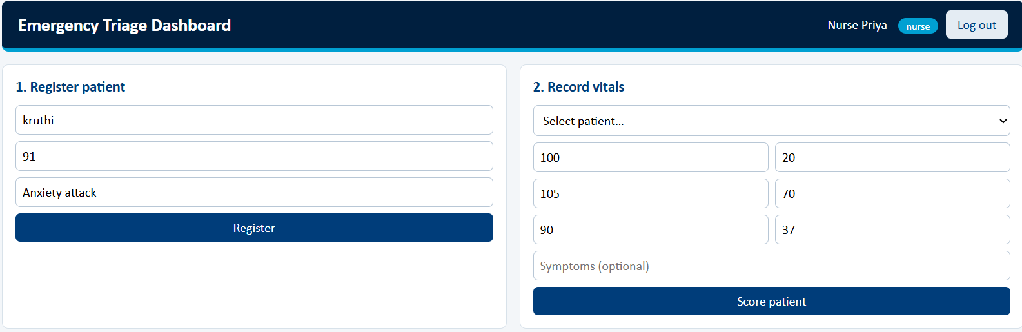
IMPLEMENTATION – WORK COMPLETED
Progress so far
GitHub: https://github.com/Varsha3331/KLH-CSE-2026-27-2420030331-Healthcare.git

Slide 10
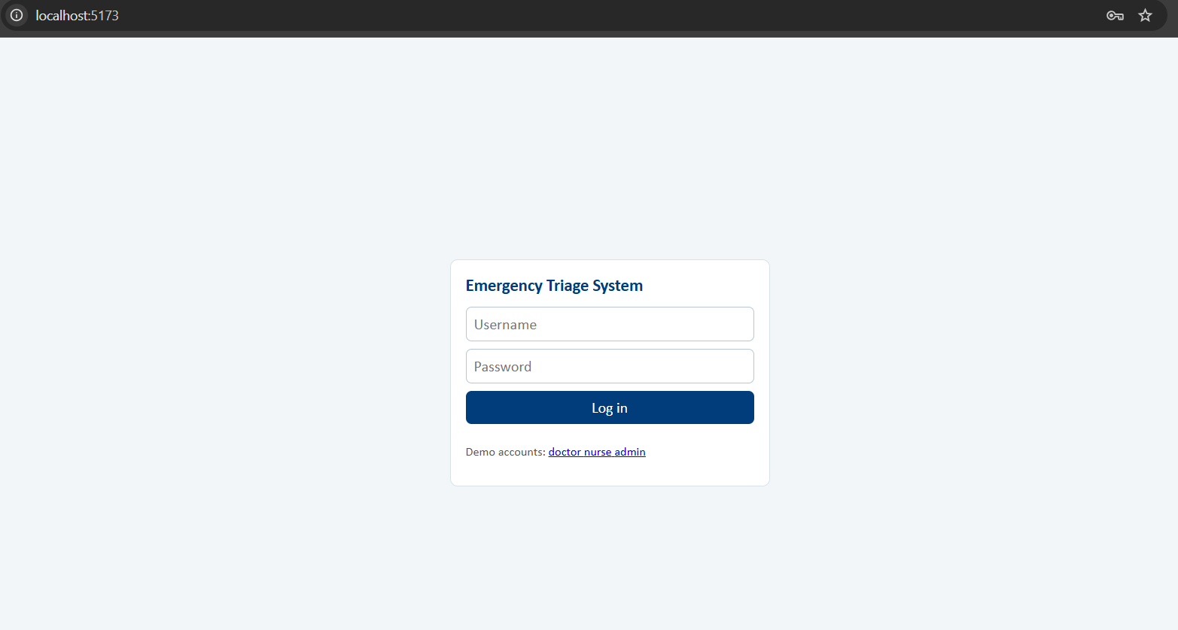

Slide 11
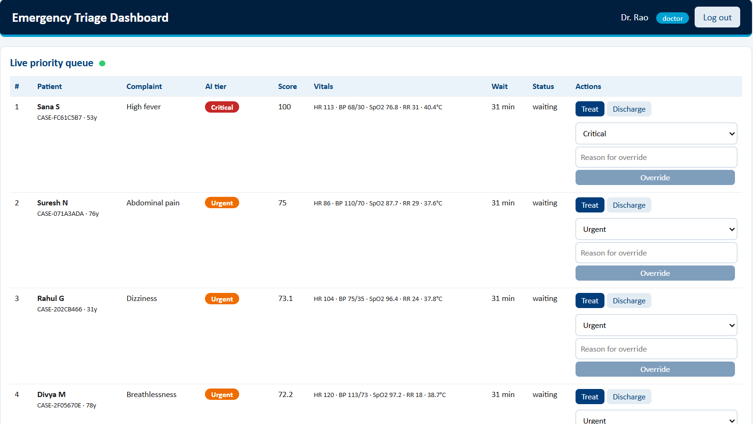

Slide 12
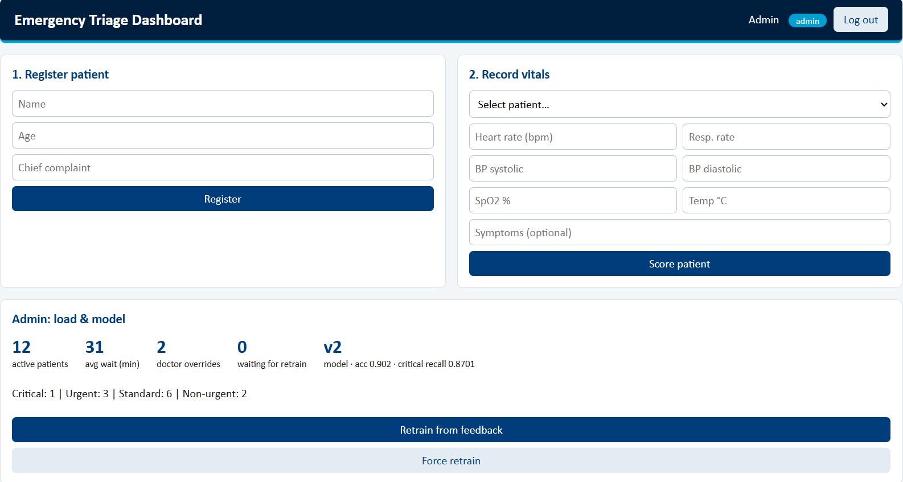

Slide 13
CONCLUSION & FUTURE SCOPE
Current status
Remaining work & future scope
Core backend, database and ML model working
Live queue and override logging in place
Frontend dashboard in progress
Role-based login and dashboards
Validation gate before model swap
Docker deployment and testing
Real clinical data and bias audit
The system moves triage from manual judgement to an adaptive, feedback-driven decision aid.

Slide 14
THANK YOU

